Slide 1
OOP CONCEPTS IN Doodle Jump Game
Presented by:
Muhammad Afnan Khan (23PWCSE2241)
Syed Muhammad Noman (23PWCSE2227)
Muhammad Saad (23PWCSE2316)

Slide 2
Overview
Introduction to the Game
OOP Concepts Applied (Class & Objects, Inheritance, Polymorphism, Encapsulation, Abstraction, Dynamic Binding, Composition)
Code Walkthrough
Key Takeaways
Game Pictures
Flowchart

Slide 3
Introduction to the Game
Doodle Jump Overview:
Simple platformer game.
Player controls a character that jumps on platforms to score points.
Platforms move when the player jumps above a threshold.
Game ends when the player falls off the screen.

Slide 4
OOP Concepts in the Game
Class and Object:
Definition: Classes are blueprints; objects are instances.
Example in the code:
Classes: GameObject, Player, Platform, Game.
Objects: A Player object, a vector of Platform objects.

Slide 5
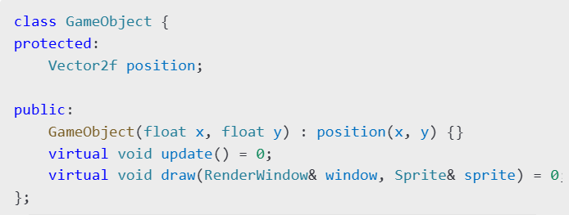
OOP Concepts in the Game
Code Example:

Slide 6
OOP Concepts(cont.)
Inheritance:
Definition: Derived classes inherit properties and methods from a base class.
Example in the code:
Platform and Player inherit from GameObject.

Slide 7
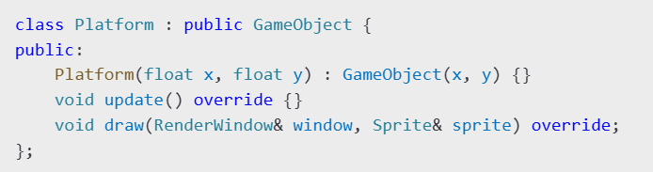
OOP Concepts (cont.)
Code Example:

Slide 8
OOP Concepts (cont.)
Polymorphism:
Definition: Methods behave differently depending on the object.
Example in the code:
Update and draw are overridden in Platform and Player.

Slide 9

OOP Concepts (cont.)
Code Example:

Slide 10
OOP Concepts (cont.)
Encapsulation:
Definition: Hiding the internal state and providing controlled access.
Example in the code:
Player's position and velocity are private.
Public methods (moveLeft, jump) provide controlled behavior.

Slide 11
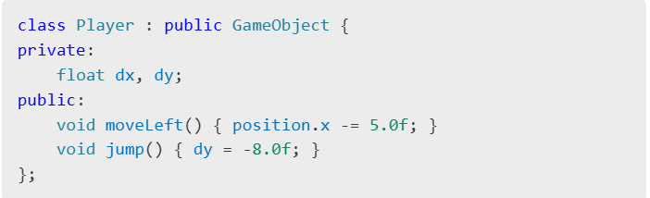
OOP Concepts (cont.)
Code Example:

Slide 12
OOP Concepts (cont.)
Abstraction:
Definition: Hiding complexity and exposing only relevant details.
Example in the code:
GameObject abstracts shared behavior for Player and Platform.
Game abstracts game management (input, collision, scoring).

Slide 13
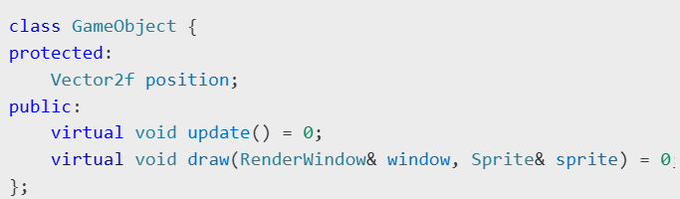
OOP Concepts (cont.)
Example in the code:

Slide 14
OOP Concepts (cont.)
Dynamic Binding:
Definition: Deciding which method to call at runtime based on the object type.
Example in the code:
Update and draw are called on GameObject pointers, but the actual method depends on the derived class.

Slide 15

OOP Concepts (cont.)
Code Example:

Slide 16
OOP Concepts (cont.)
Composition:
Definition: "Has-a" relationship where a class contains objects of other classes.
Example in the code:
Game contains Player and Platform objects.
Game also uses Sound, Sprite, and Text objects for additional functionality.

Slide 17

OOP Concepts (cont.)
Code Example:

Slide 18
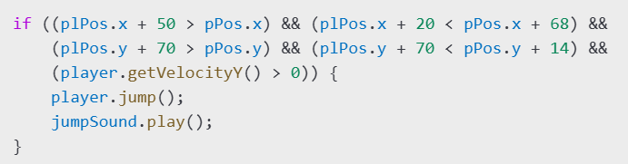
Key Functions in the Game
Collision Detection:
Checks if the player intersects with any platform.
Code Example:

Slide 19
Game Loop
Overview:
Continuously runs while the window is open.
Handles:
Input, Object updates (Collision detection), Rendering

Slide 20
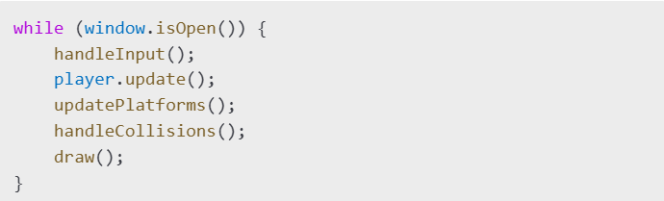
Game Loop (cont.)
Code Example:

Slide 21
Key Takeaways
OOP Simplifies Development:
Clear separation of responsibilities.
Easier to add new features (e.g., enemies, collectibles).
Reusability and Scalability:
Classes and inheritance make it easy to reuse code.
Encapsulation Enhances Maintainability:
Controlled access ensures fewer bugs.

Slide 22


Game Pictures

Slide 23
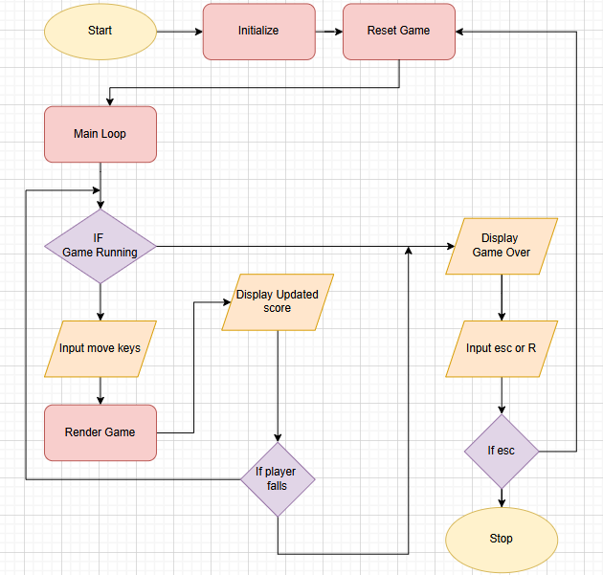
Flowchart

Slide 24
THANK YOU!

